Slide 1
HEART of San Mateo County
Some projects with unique challenges…
The John Stewart Company
Friday, May 15, 2015

Slide 2
Snap shots of 6 projects which have these common characteristics…
Dysfunctional and fallow properties
Bad histories
Long shots
Public-private partnerships
Non-profit/for-profit partnerships
Low/moderate income
Long pre-development phase
Complex financing
Public official foster parents

Slide 3
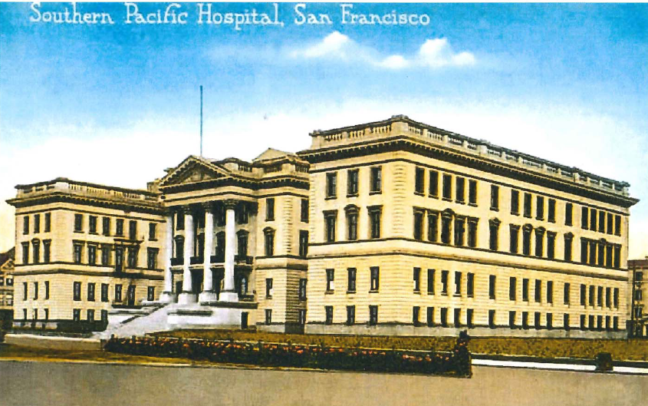

Slide 4
Mercy Terrace
Adaptive reuse of circa 1911/1920 Southern Pacific Hospital for Seniors – 158 units and Families – 36 units in San Francisco

Slide 5
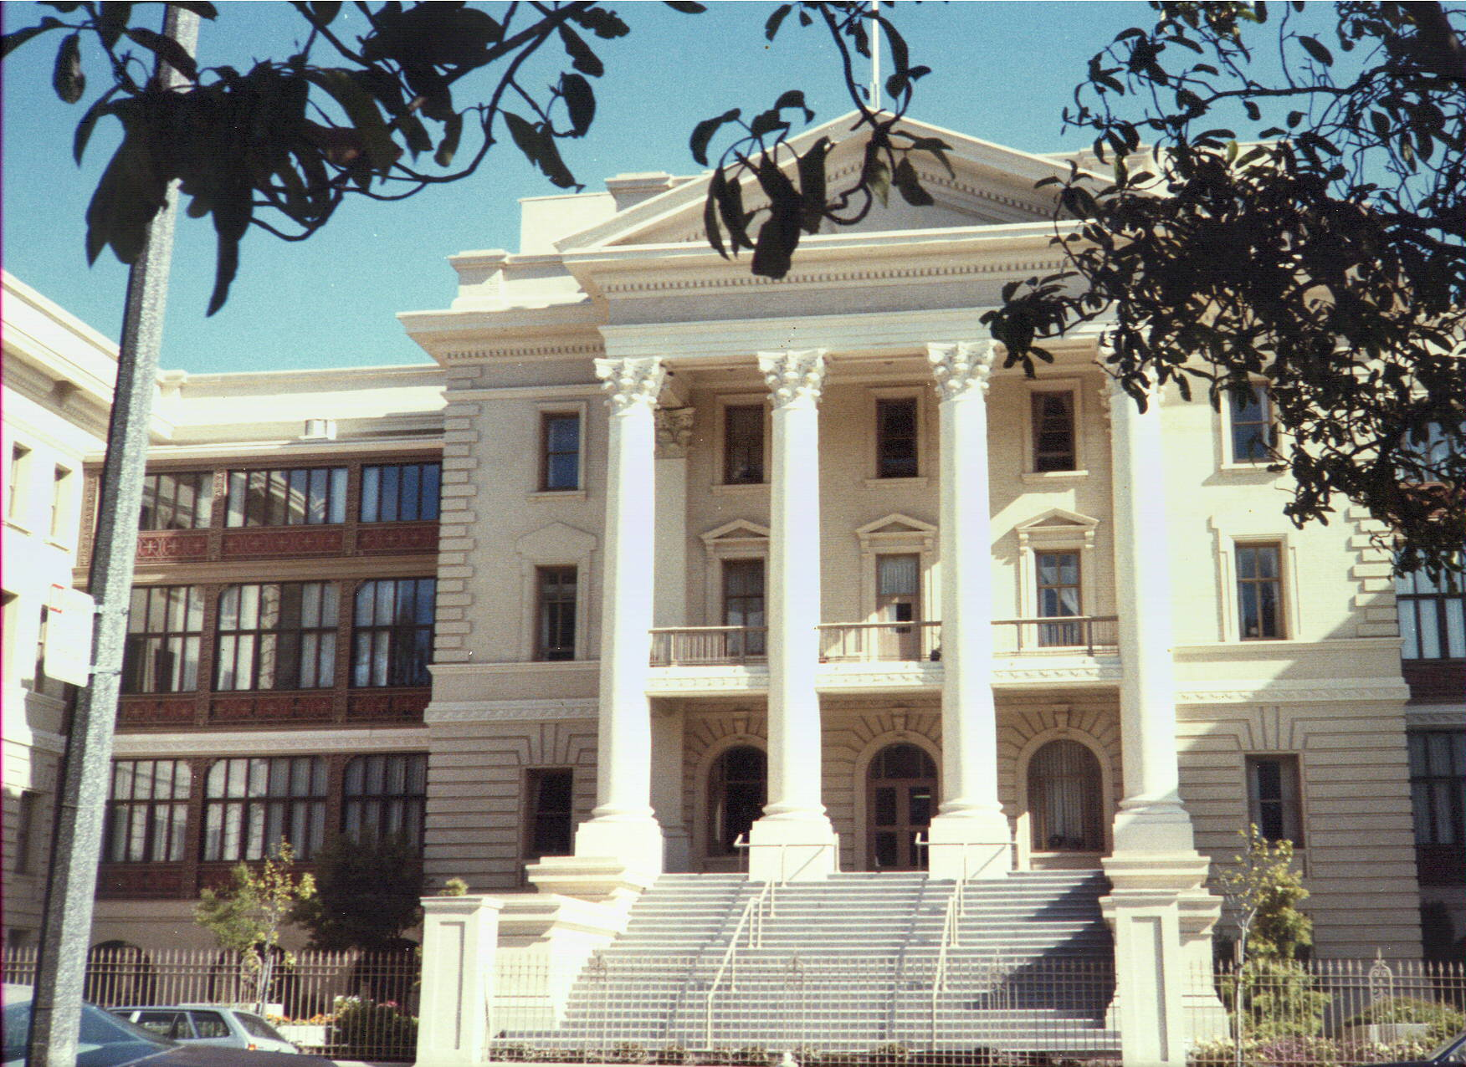
Mercy Terrace

Slide 6
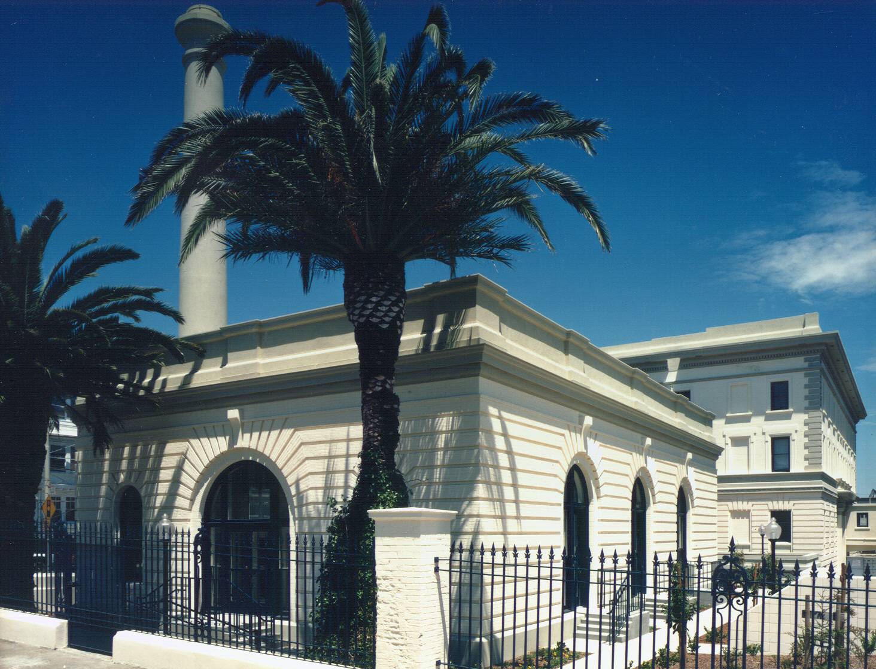
Mercy Terrace

Slide 7
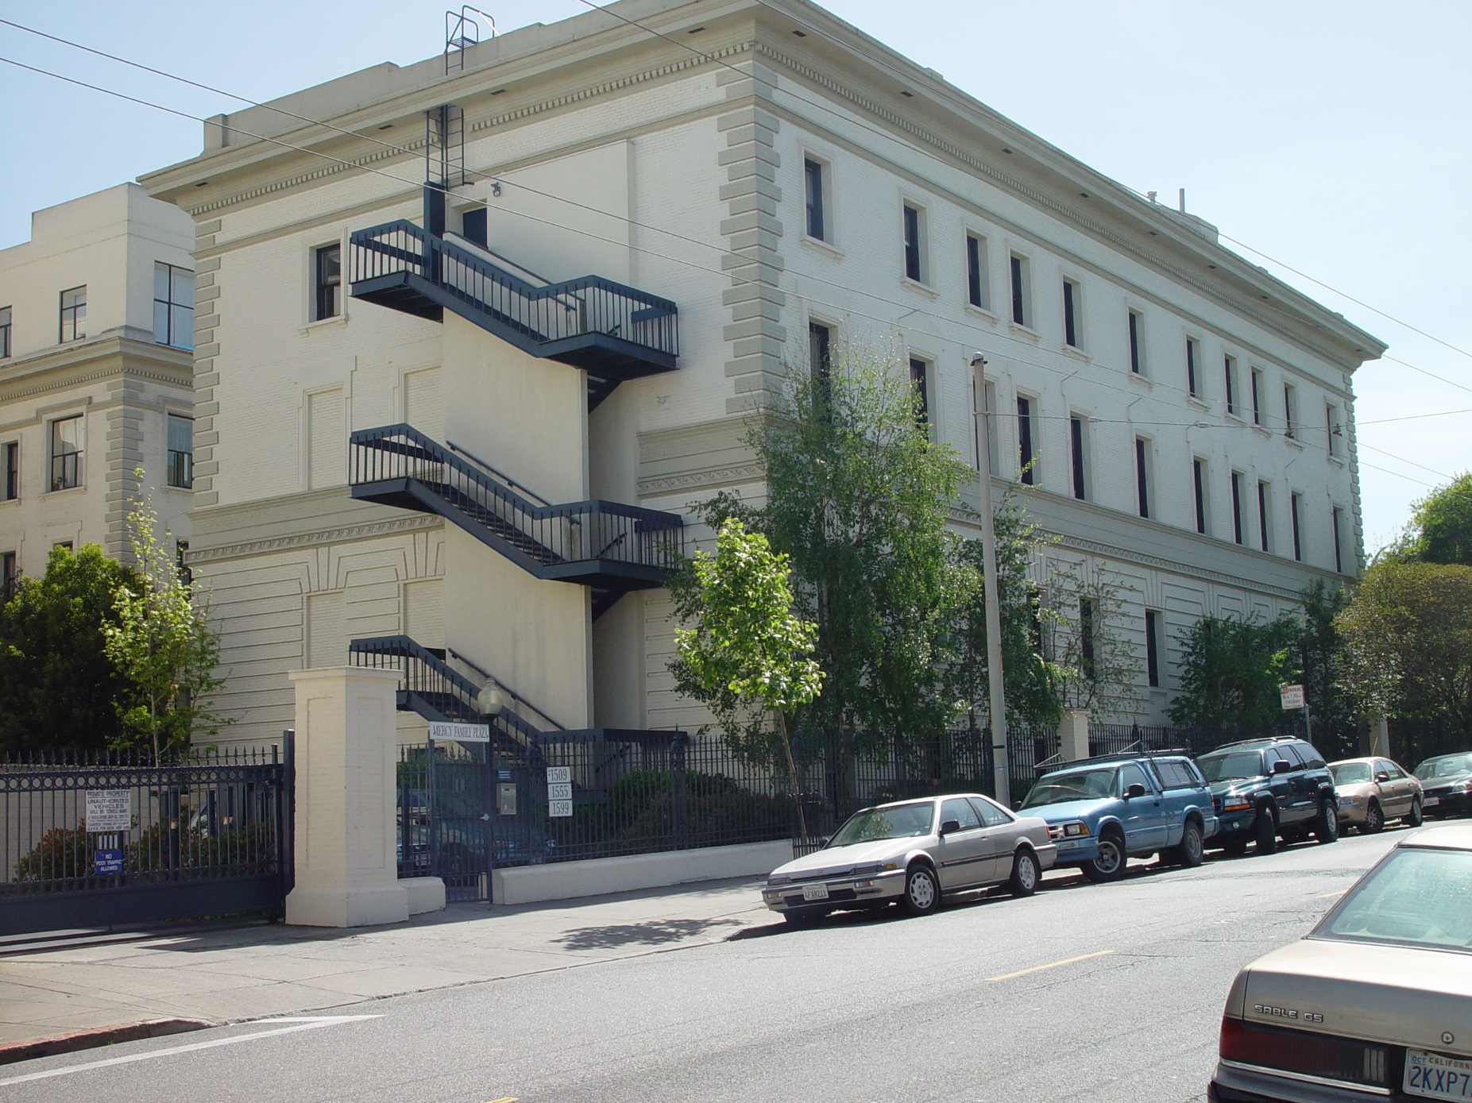
Mercy Terrace

Slide 8
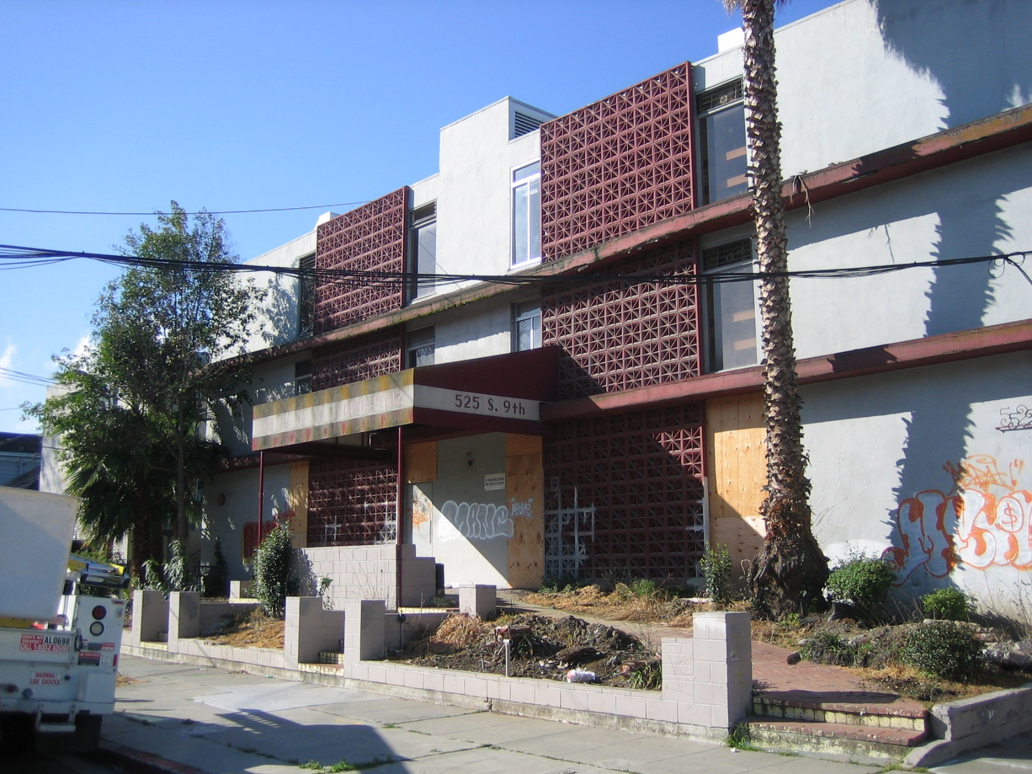
Casa Feliz (circa 1994) San Jose, CA

Slide 9
CASA FELIZ
The back story
Former S.J. State sorority (circa 1950’s) became…
  59 units/6 BA for persons with mental disabilities (mid ‘90’s)
  Loans from City of San Jose & State (HCD) to non-profit owner
  JSCo management contract
  Owner declared bankruptcy
  Court approved abandonment
  JSCo de facto owner for 7 years, without client
  Work-out with City/State
  JSCo and First Community Housing form partnership
  Temporary relocation funding found
  New project, same mission

Slide 10
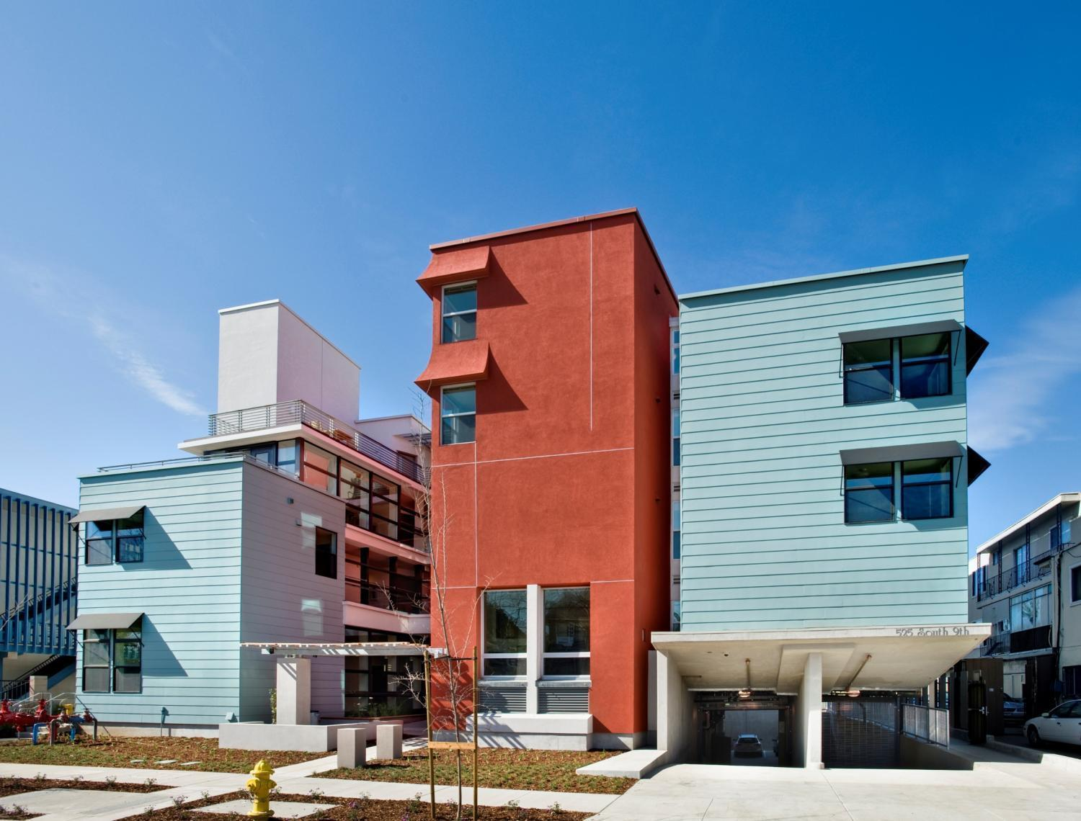
Casa Feliz

Slide 11
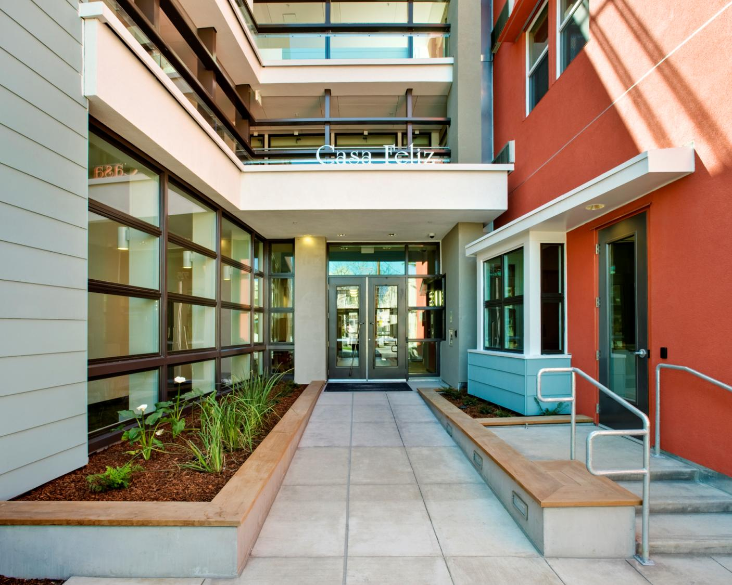
Casa Feliz today

Slide 12
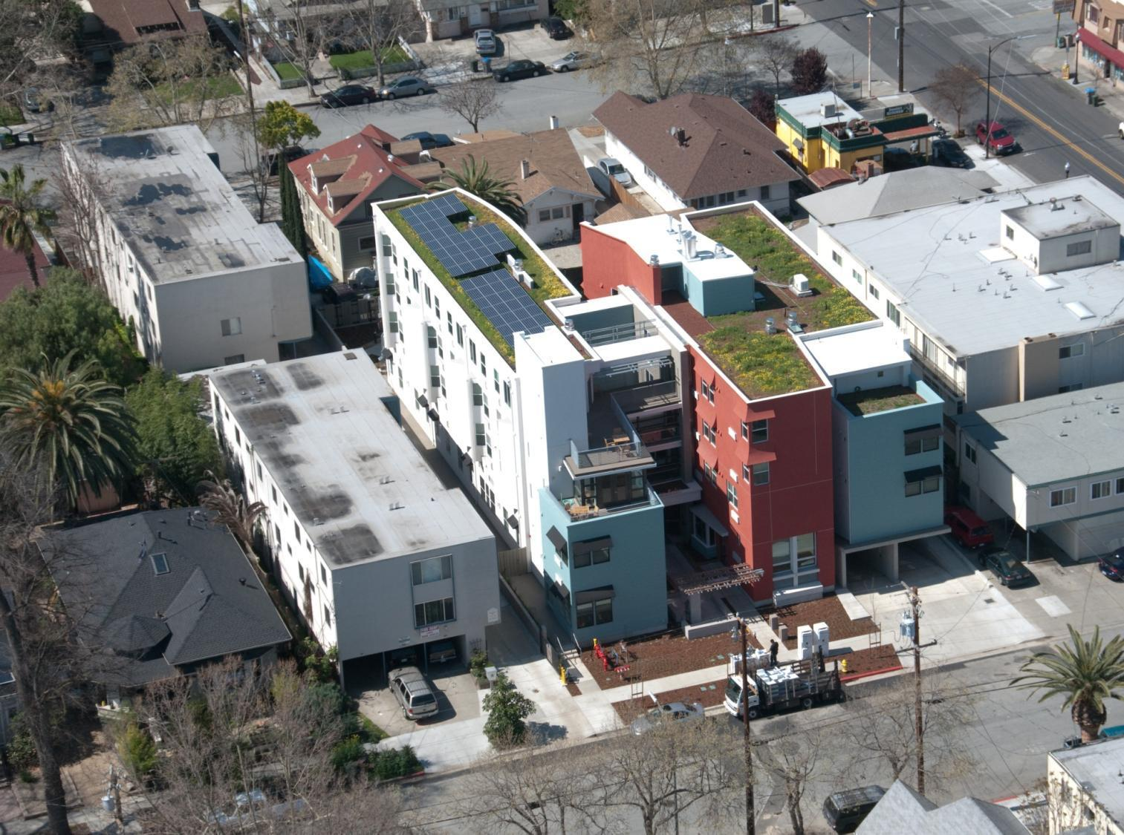
Casa Feliz

Slide 13
CASA FELIZ
Project Overview today
60 studio units affordable to extremely low-income tenants
21 units for developmentally disabled tenants
Redeveloped 0.34-acre site
Located near downtown San Jose and San Jose State University
Construction completed March 2009
LEED-NC 2.2 Gold certified

Slide 14
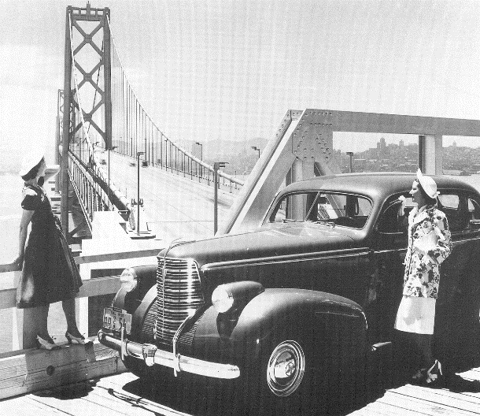
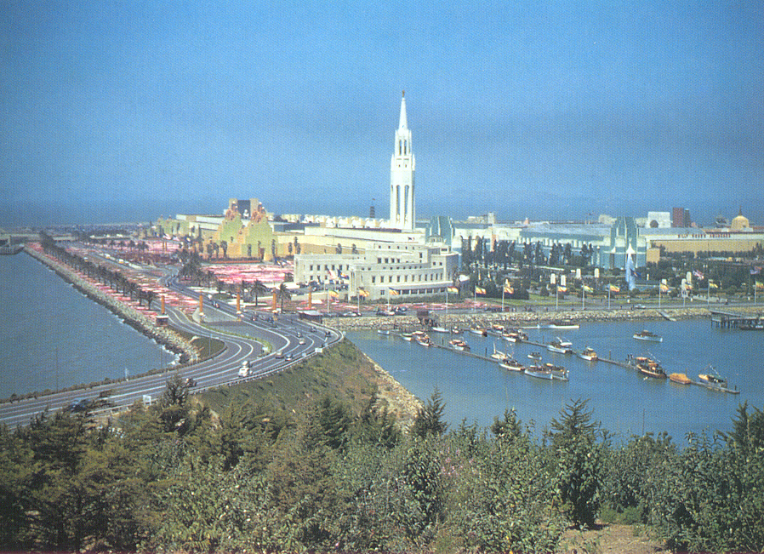
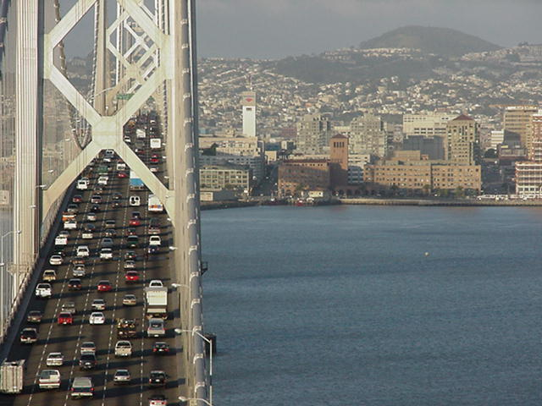
Treasure Island (1939)

Slide 15
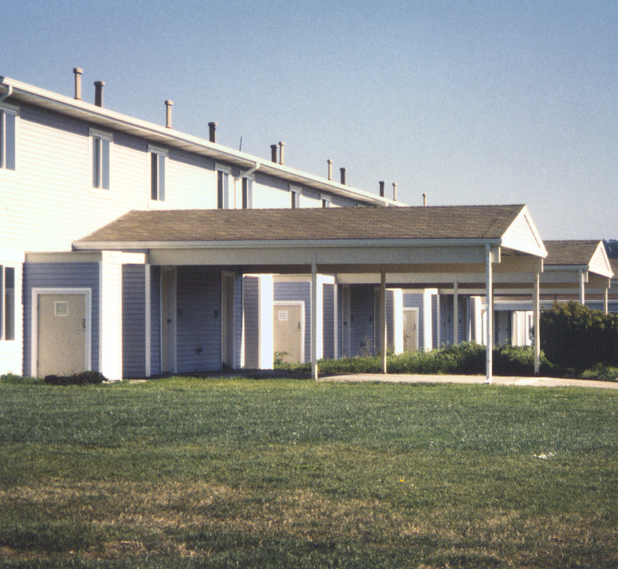
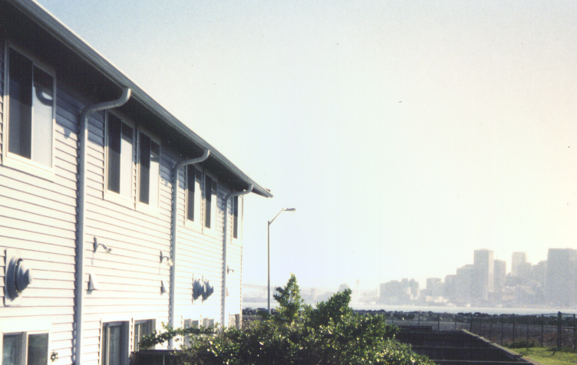
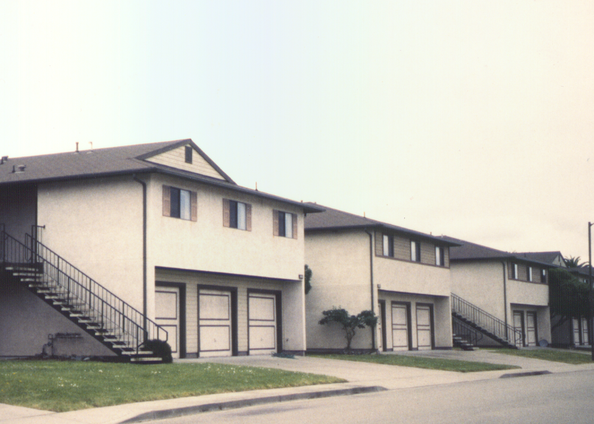
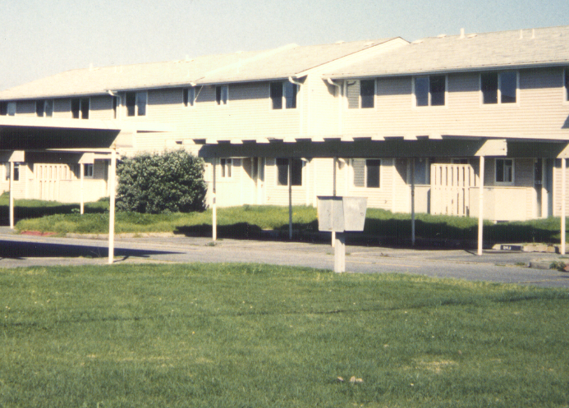
Housing was built for Navy personnel in the 1960’s, 70’s and 80’s
Treasure Island

Slide 16
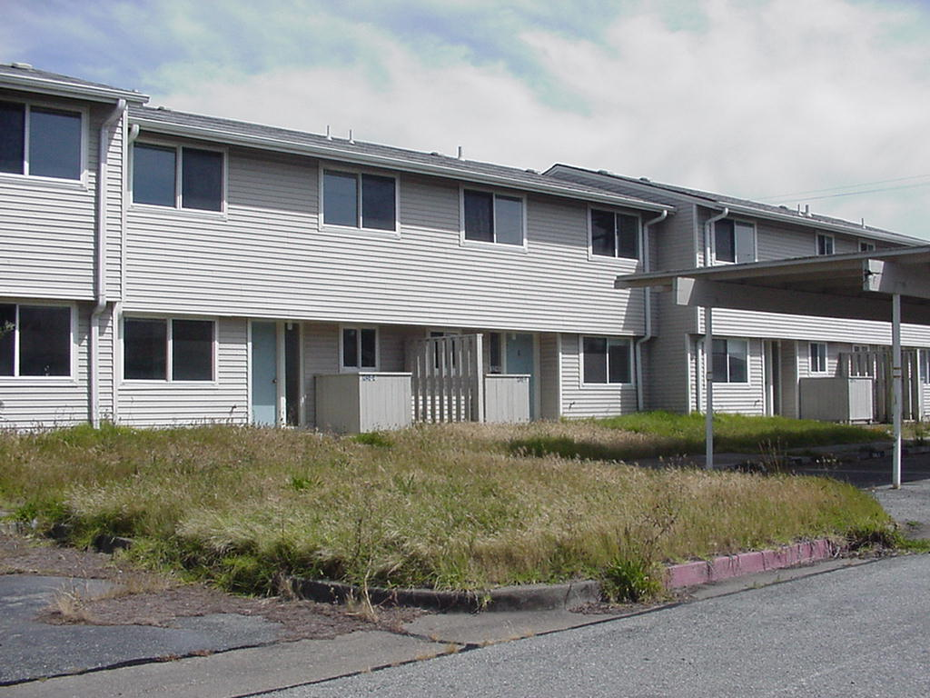
The Base was decommissioned in 1997 and the housing stood empty
Treasure Island

Slide 17
Status in 1999
Land and 650 vacant units owned by Navy
Treasure Island Development Authority (TIDA) has lease from Navy
JSCo has sub-lease from TIDA
Work statement: Invest, Rehabilitate, market, lease all housing
Environmental clean-up issues with Navy & DTSC (FOSL)
No schools
Poor transit
No grocery, drug, retail stores
Interspersion of 220 units of formerly homeless families
No willing conventional lender
$7-10M up-front capital

Slide 18
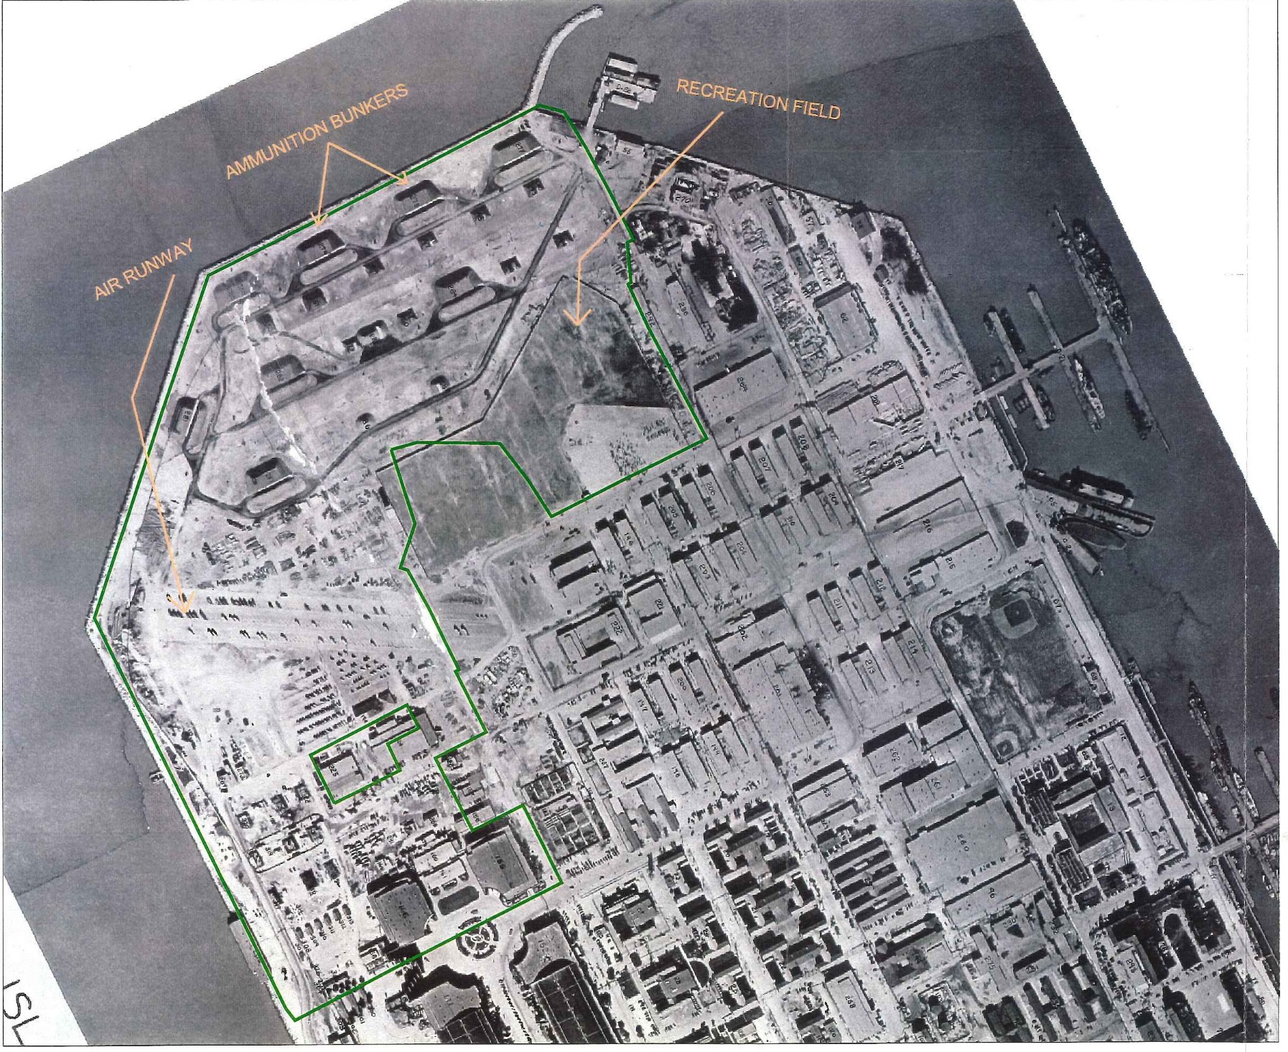
T.I. 1945

Slide 19
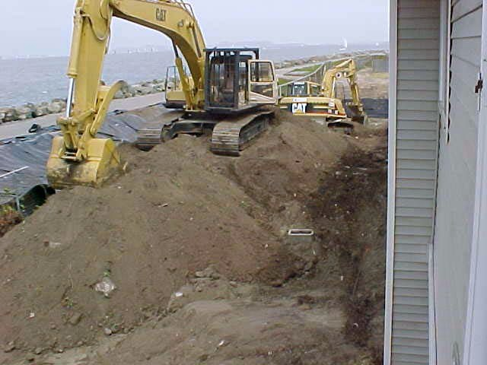
Unplanned Remediation

Slide 20
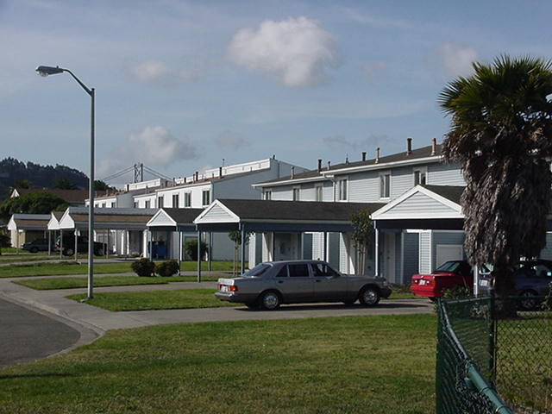
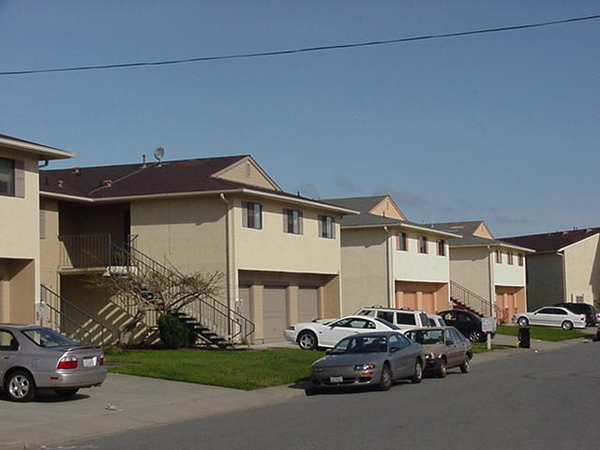
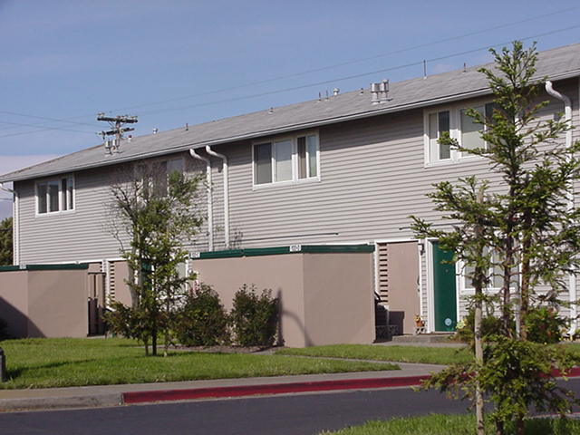
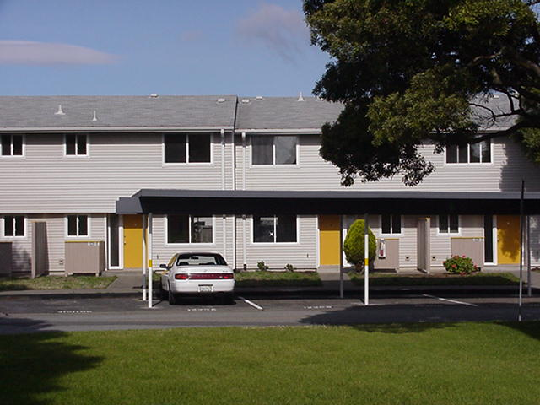
Rehabilitated for interim use

Slide 21
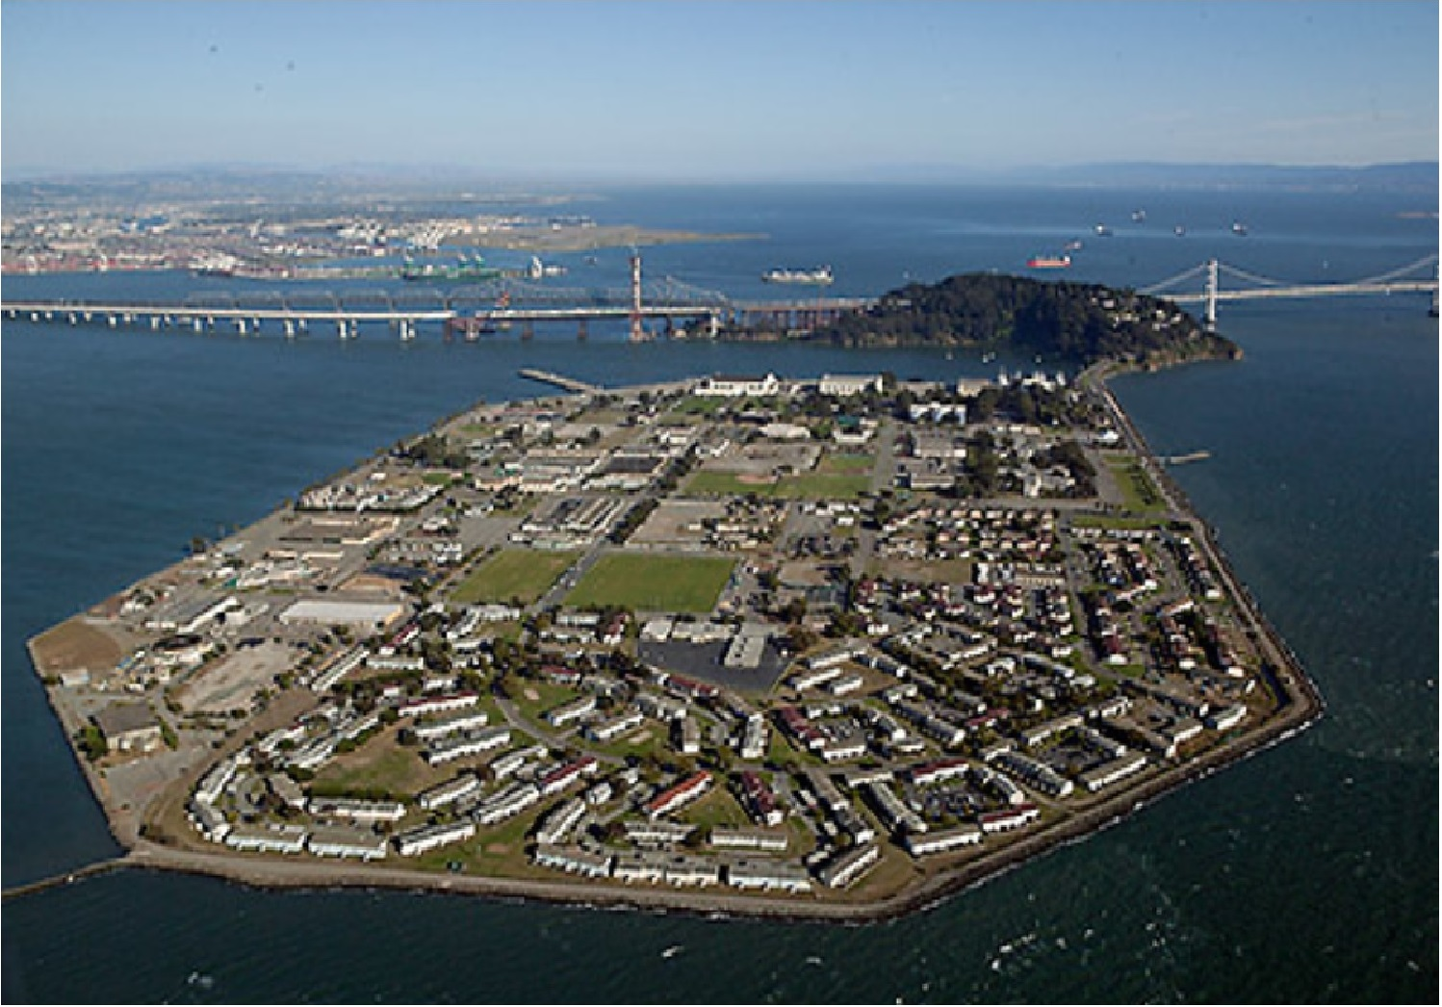
Treasure Island today

Slide 22
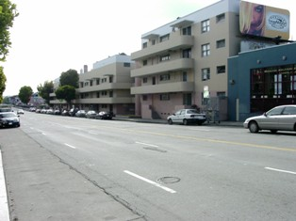
North Beach S.F. Public Housing
(221 Units) Circa 2000

Slide 23
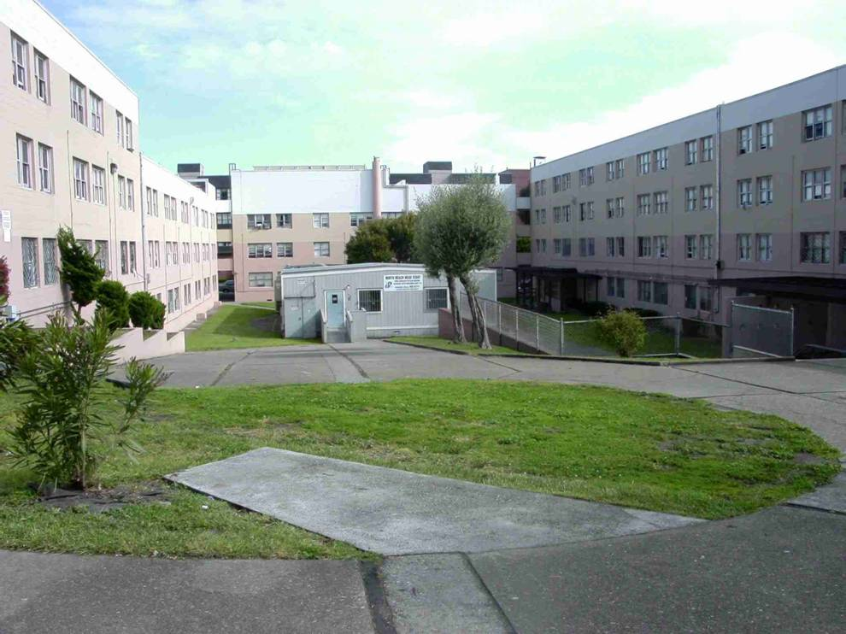
North Beach S.F. Public Housing
Circa 2000

Slide 24
Historical Overview, year 2000
Punitive Post WWII design
221 units owned & operated by S.F.H.A. for 60 years
High crime, high operating costs
Operating deficits
Bane of North Beach
Bane of S.F. Mayors
Knock-down & rebuild schemes came up short because…
Complex transaction with Housing Authority
HUD sanctions on SFHA
Lack of financing
Tenant fear of displacement
Relocation funding during construction
Geotech challenges

Slide 25
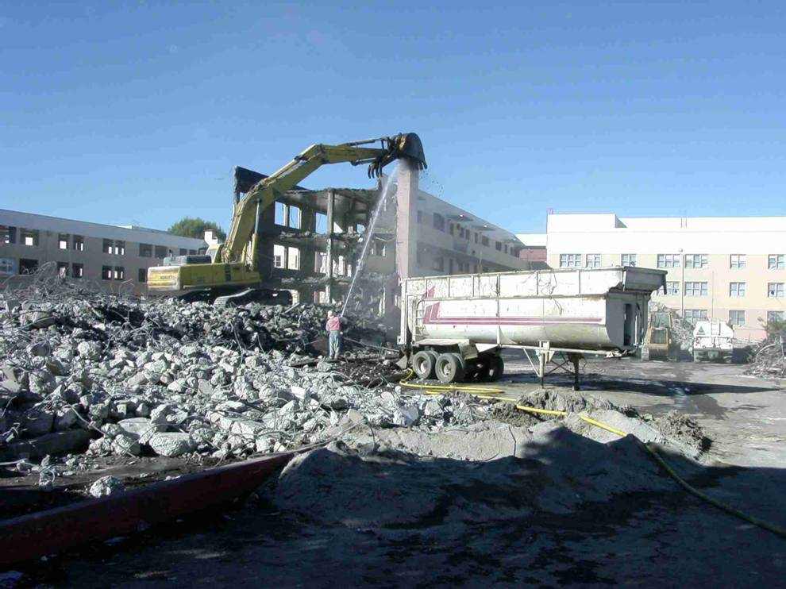
North Beach S.F. Public Housing
Demolition 2003

Slide 26
North Beach Place proceeds in 2002
341 HOPE VI project
1,2,3 &4 bedrooms
2/3 public housing and 1/3 tax credit
Public/private venture
Mixed use (21,000 Sq. Ft. Retail)
Mixed age
Mixed income
Contractors: Nibbi/Cahill
Architect: Paul Barnhart/Trotka
Developer: Bridge/Em Johnson/JSCo

Slide 27
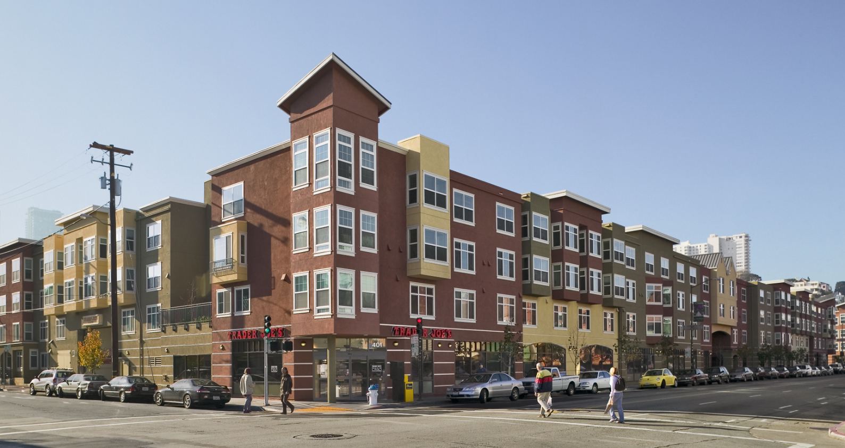
North Beach Place today

Slide 28
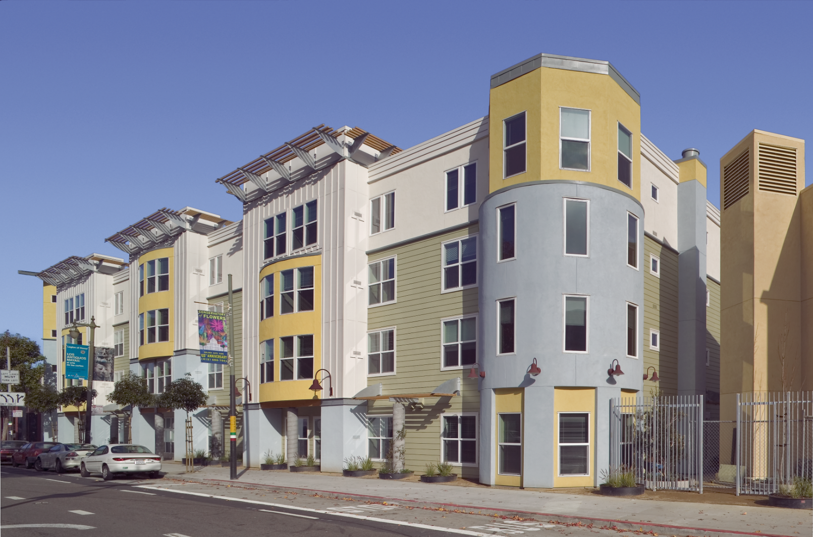
North Beach Place

Slide 29
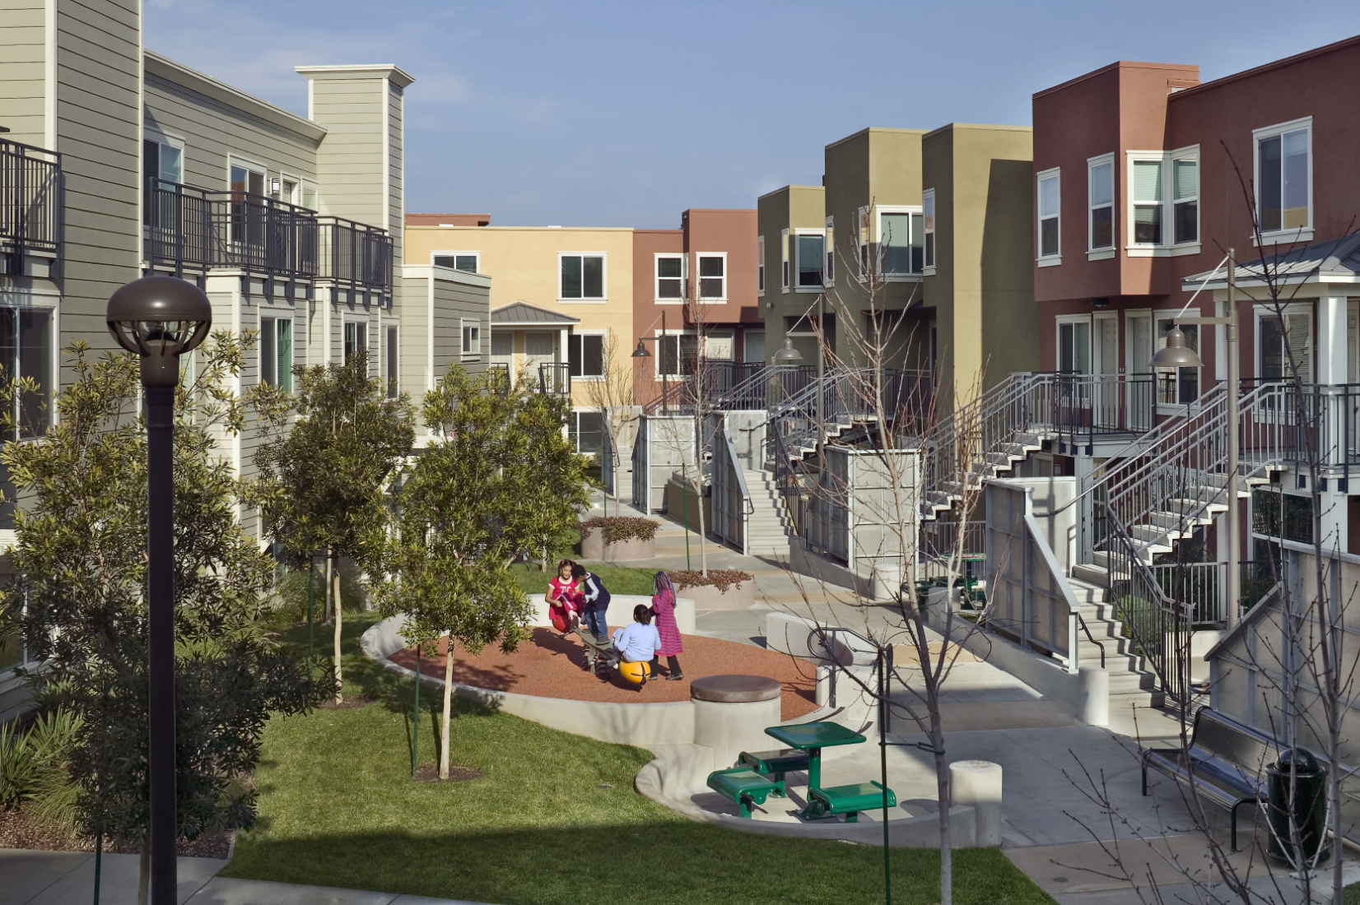
North Beach Place

Slide 30
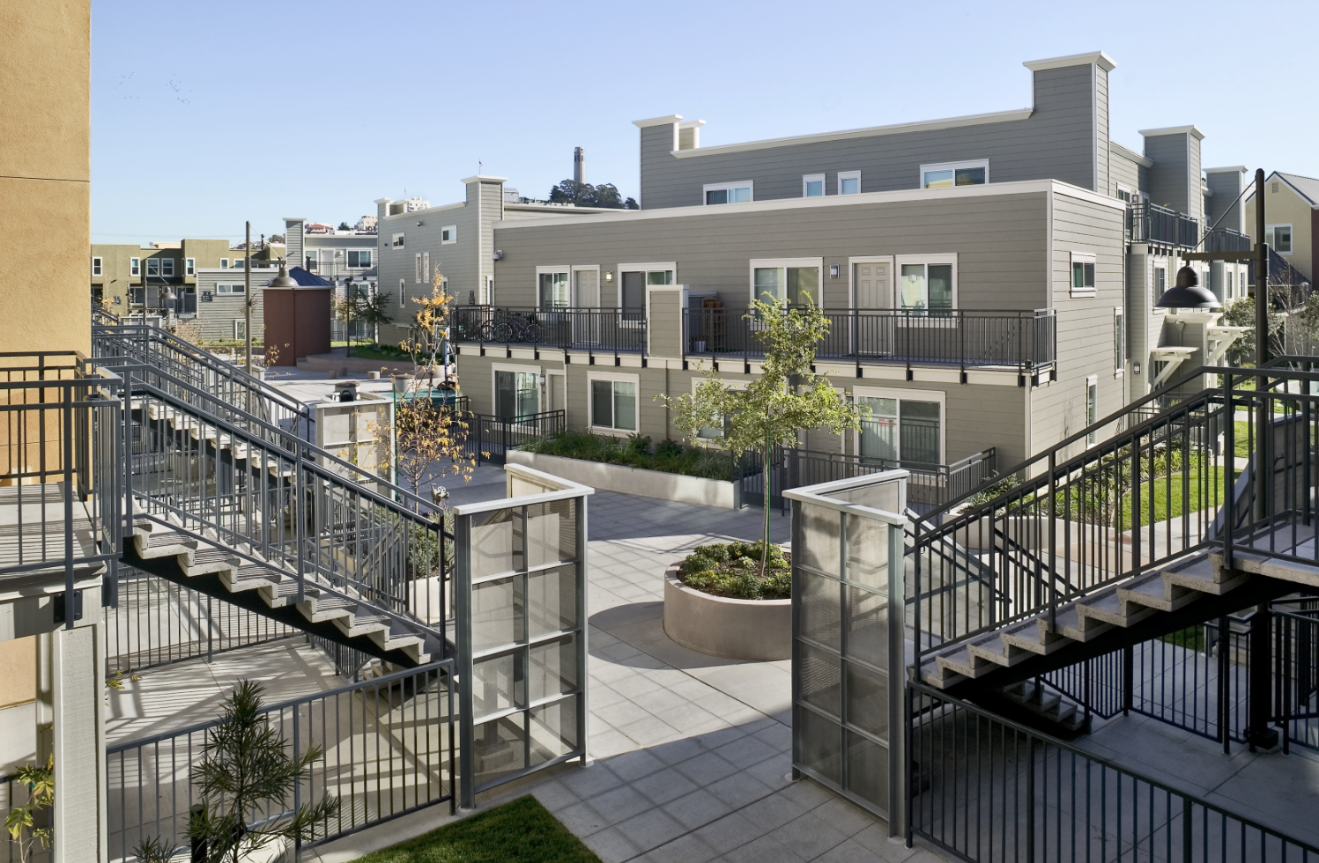
North Beach Place

Slide 31
Hunters View

Slide 32
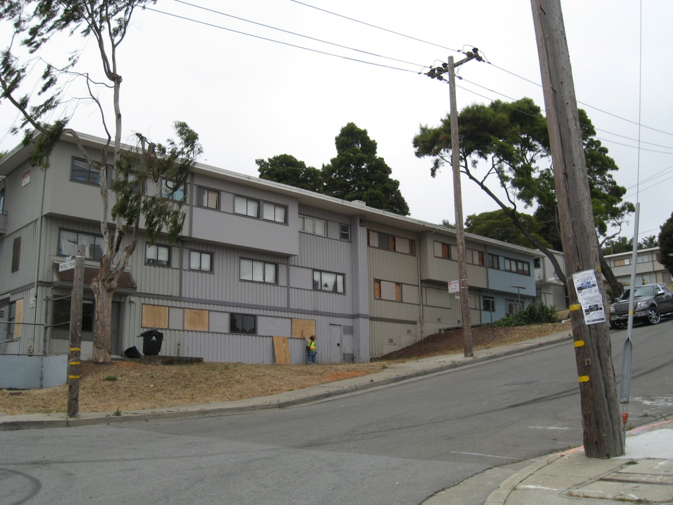
Pre-construction
Hunters View

Slide 33
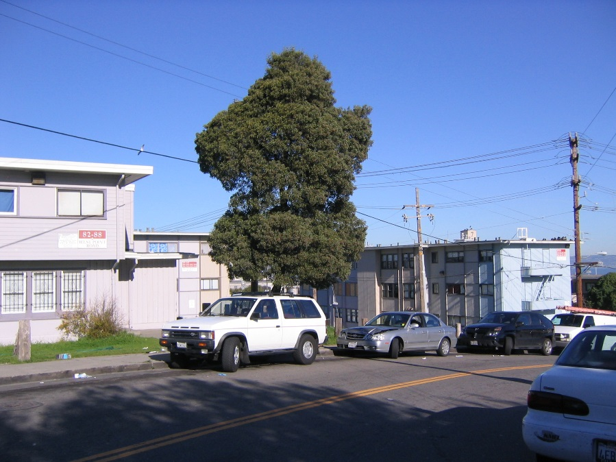
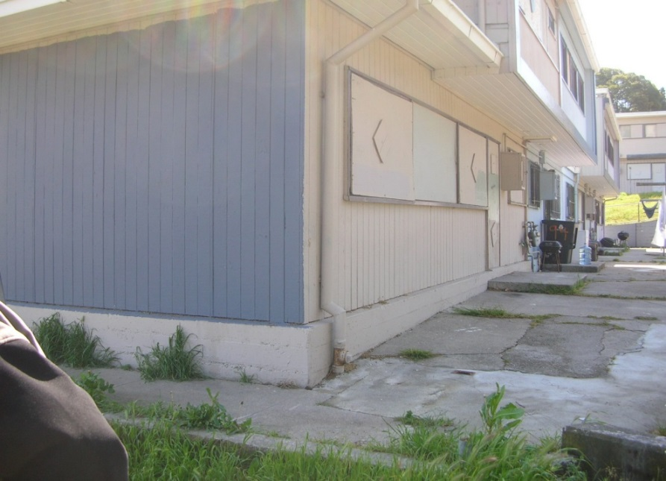
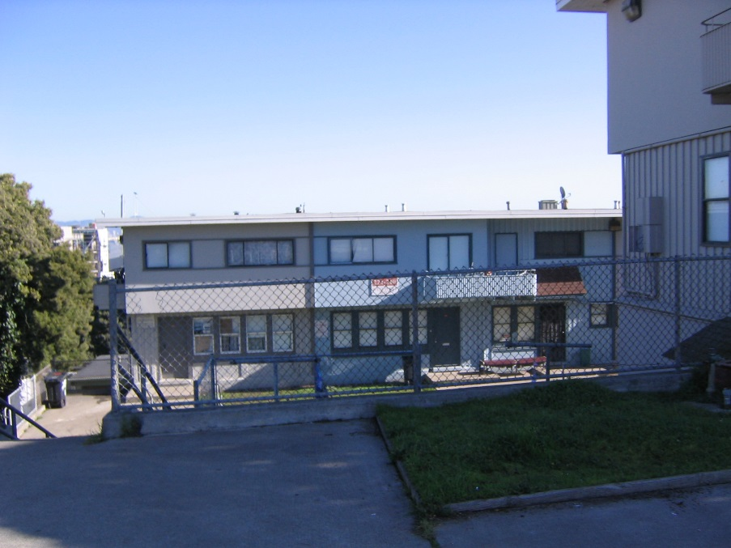
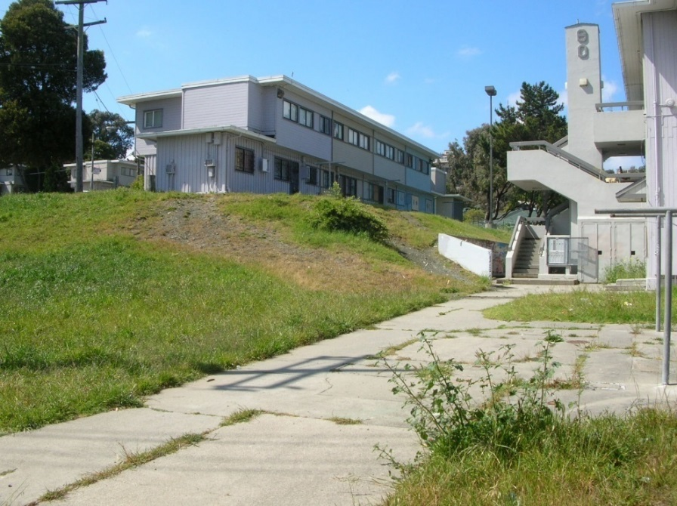
Pre-construction
Hunters View

Slide 34
Barriers to development
  No HOPE VI Grant from HUD
  Unsafe neighborhood
  Push back on gentrification
  Over 100 community meetings in Phase I alone
  Naturally occurring asbestos
  Steep slope site
  Need to cobble together multiple financing sources…

Slide 35
Hunters View financing sources
(Phases I & II only)
S.F. Housing Authority
S.F. Redevelopment Agency
City of San Francisco (HOPE SF)
State of California (Prop 1-C)
Housing Trust of Silicon Valley
AHP
Enterprise Foundation (LiHTC)
Wells Fargo (LiHTC)
Baytree Foundation (Education)
LISC
San Francisco Foundation
Ford Foundation (Grant & PRI’s)
Fannie Mae
Stewardship Council

Slide 36
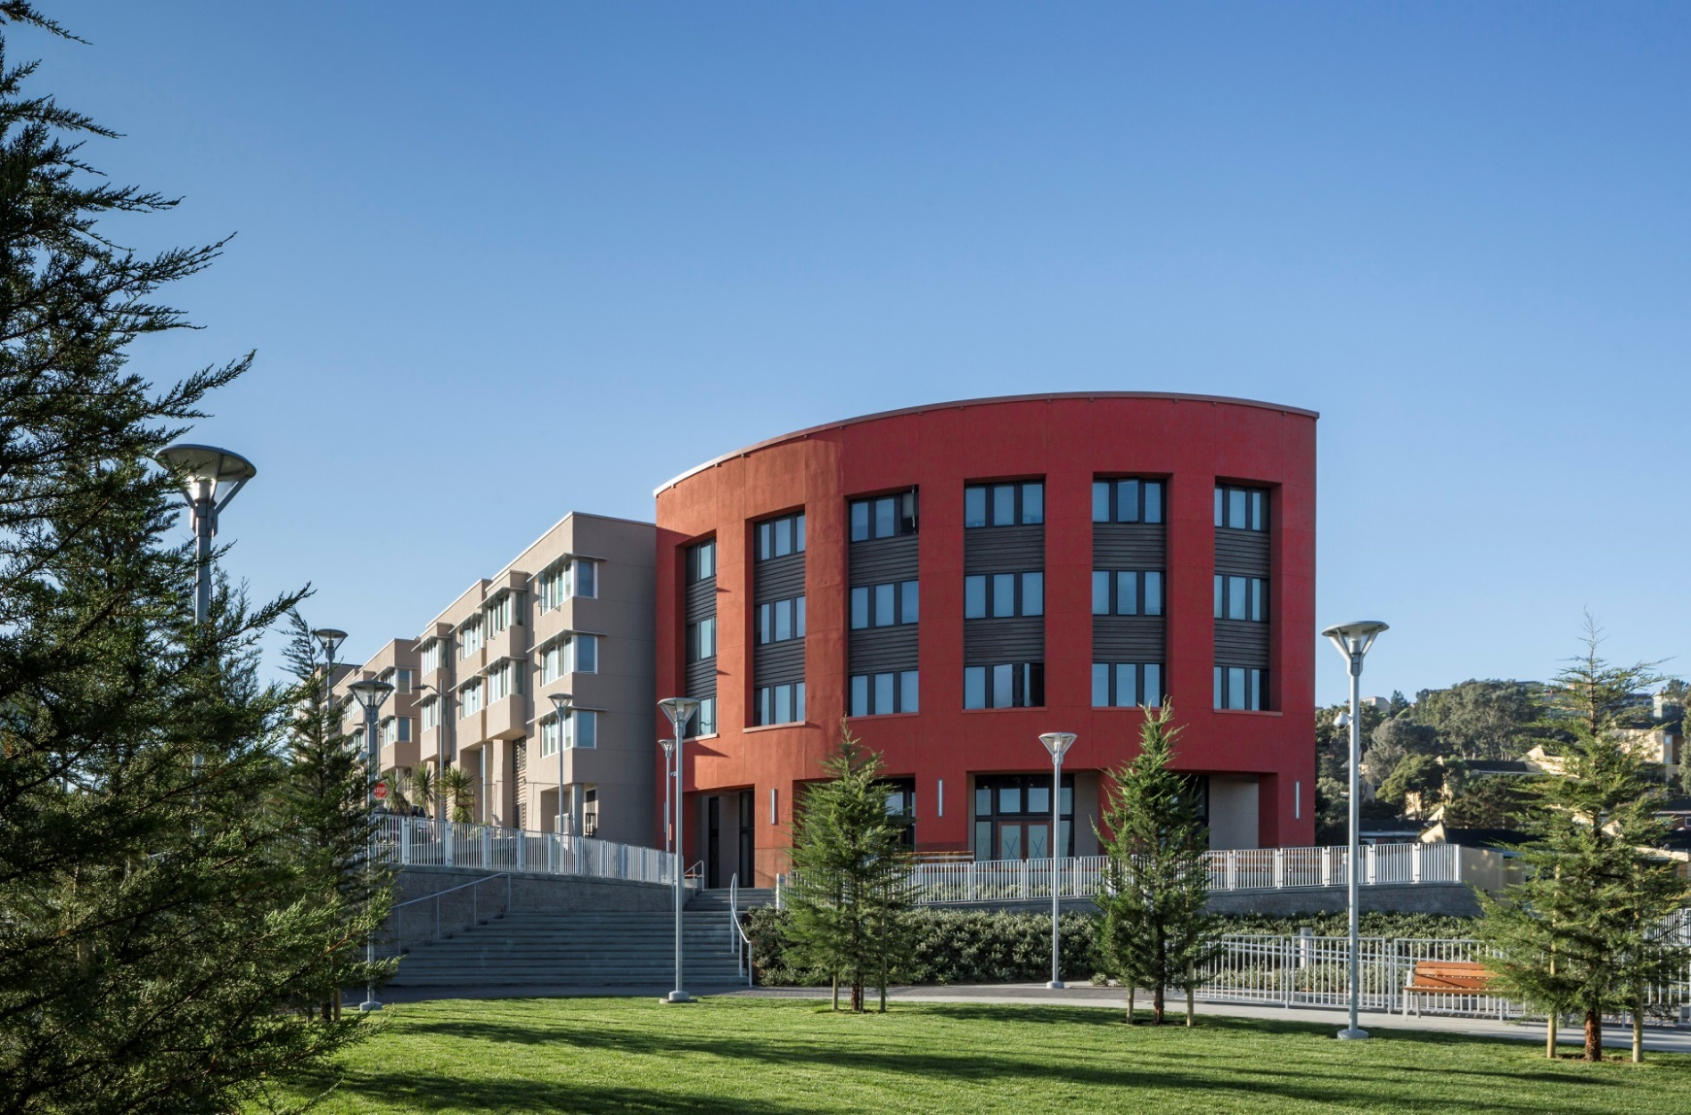
Hunters View Phase 1

Slide 37
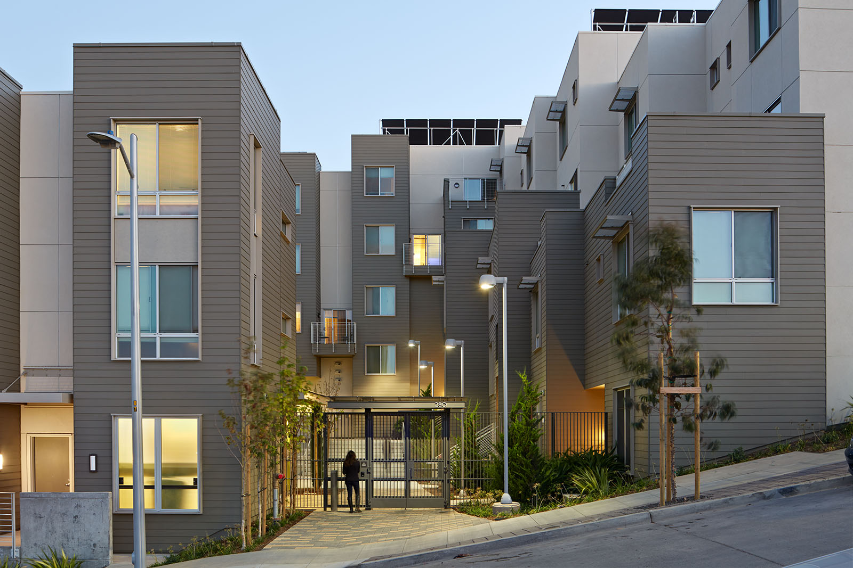
Hunters View Phase 1

Slide 38
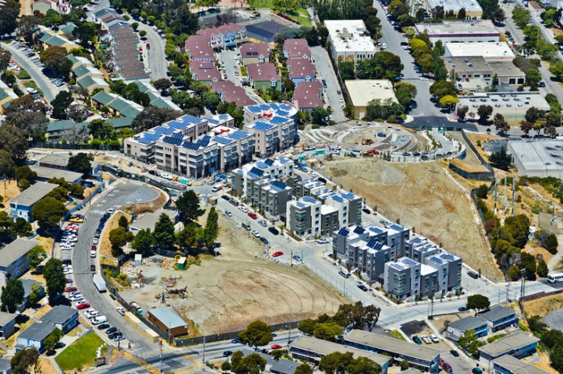
Hunters View Phase 1

Slide 39
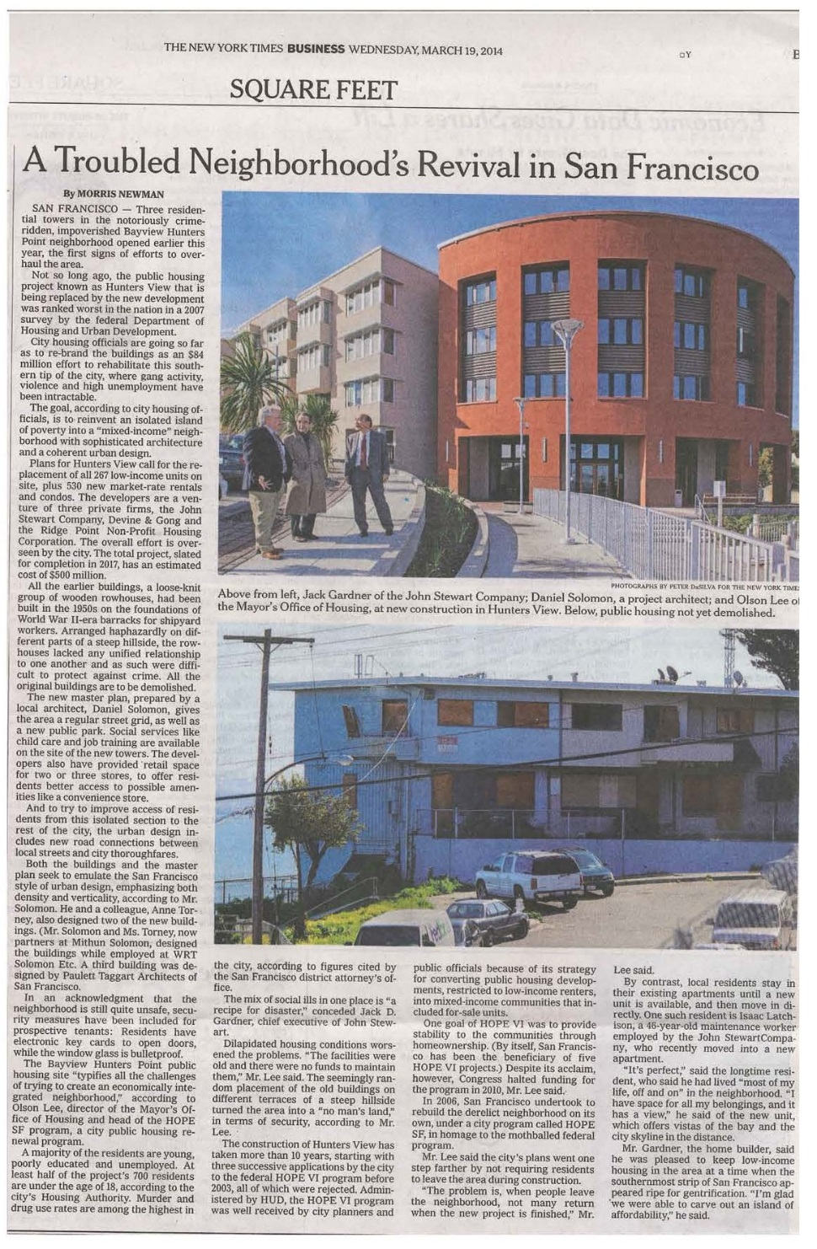

Slide 40
Hunters View Today
HOPE SF Bond Project
Public/private venture with San Francisco Housing Authority
740 units
22 acres
Phase I (complete): affordable rental using LiHTC, Prop 1-C, other sources
Phase II (under construction): same, plus Habitat for Humanity
Phase III/IV: Market rate rental and condos
Tax credit purchasers: Enterprise & Wells Fargo
Architect: Solomon/Taggart/Baker
Contractors: Nibbi /Cahill
Developers: JSCo/Devine & Gong/Ridge Point

Slide 41
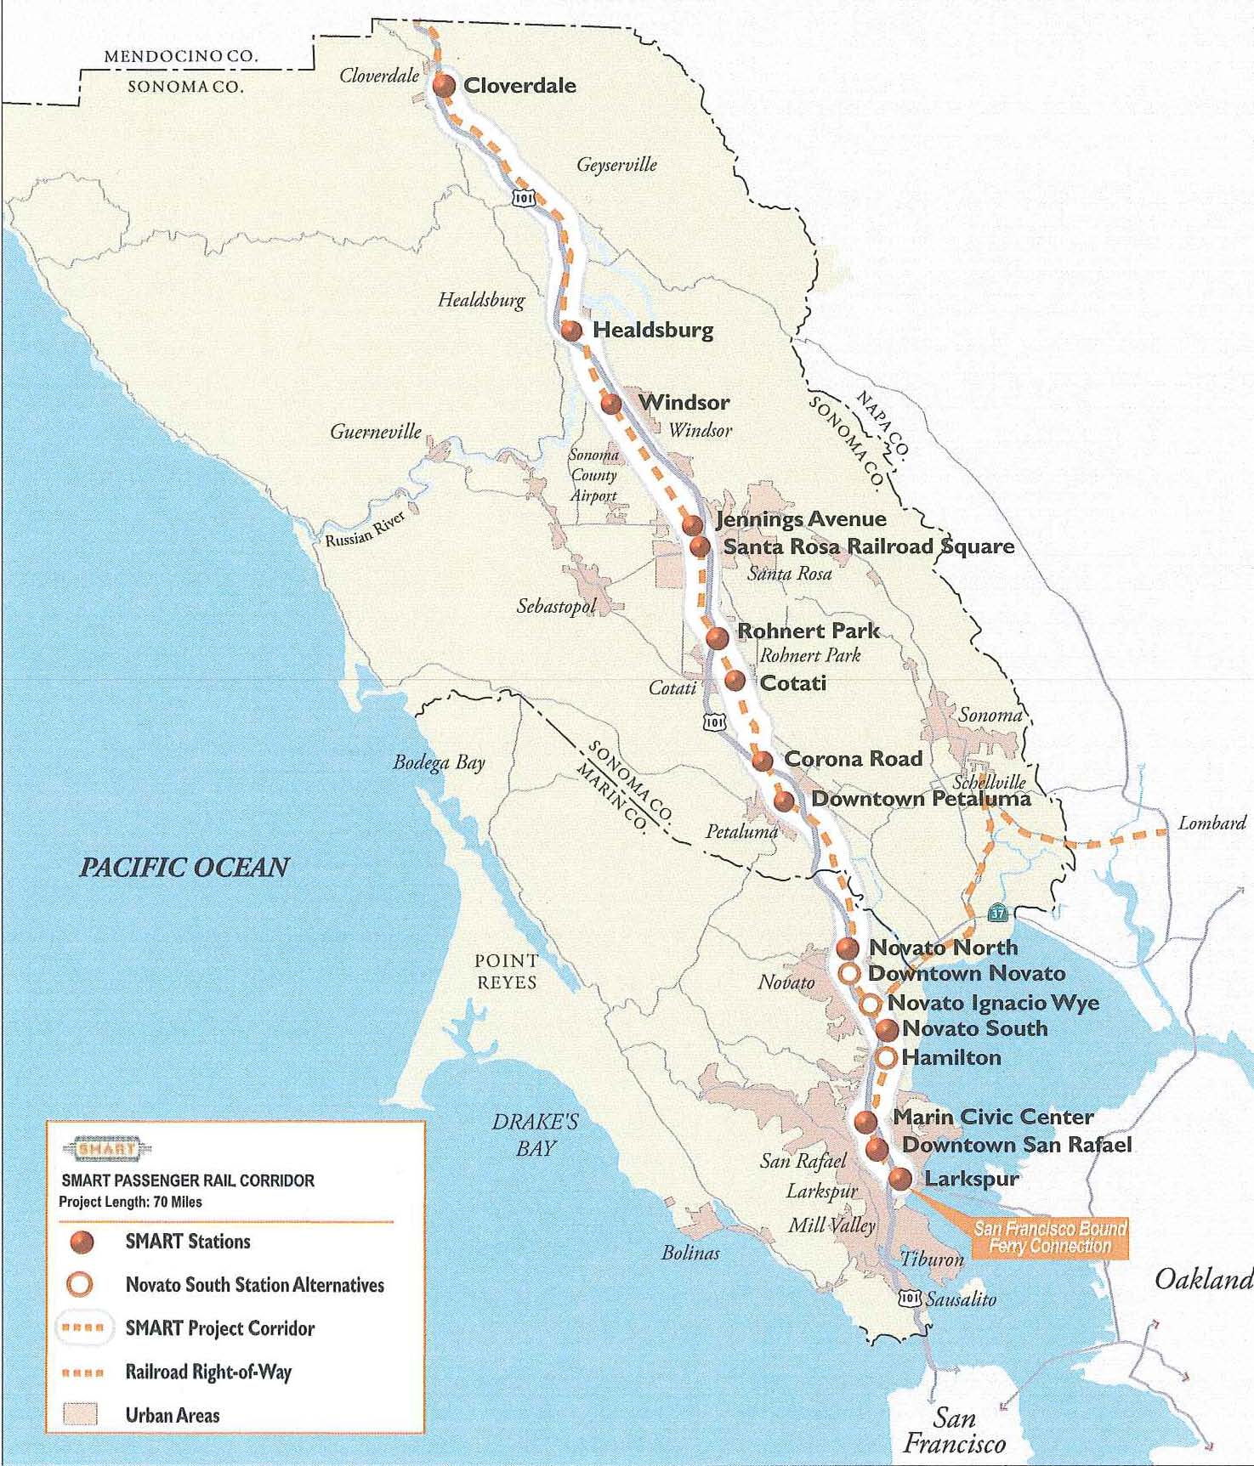
SMART Passenger Rail Corridor
Railroad Square
Santa Rosa, CA

Slide 42
The Cannery and Plant 5 in 1999
  A transit-oriented development tied to SMART
  Bought two 1908 cannery buildings next to Santa Rosa Railroad Station
  Preserved/braced some historic walls
  4-year clean up of soil & ground water
  Entitled 93 units of affordable senior housing in 2008
  Awarded $11.3M of Prop 1-C Grant Funds in 2009
  Became eligible for $5.5M of RDA Funds

Slide 43
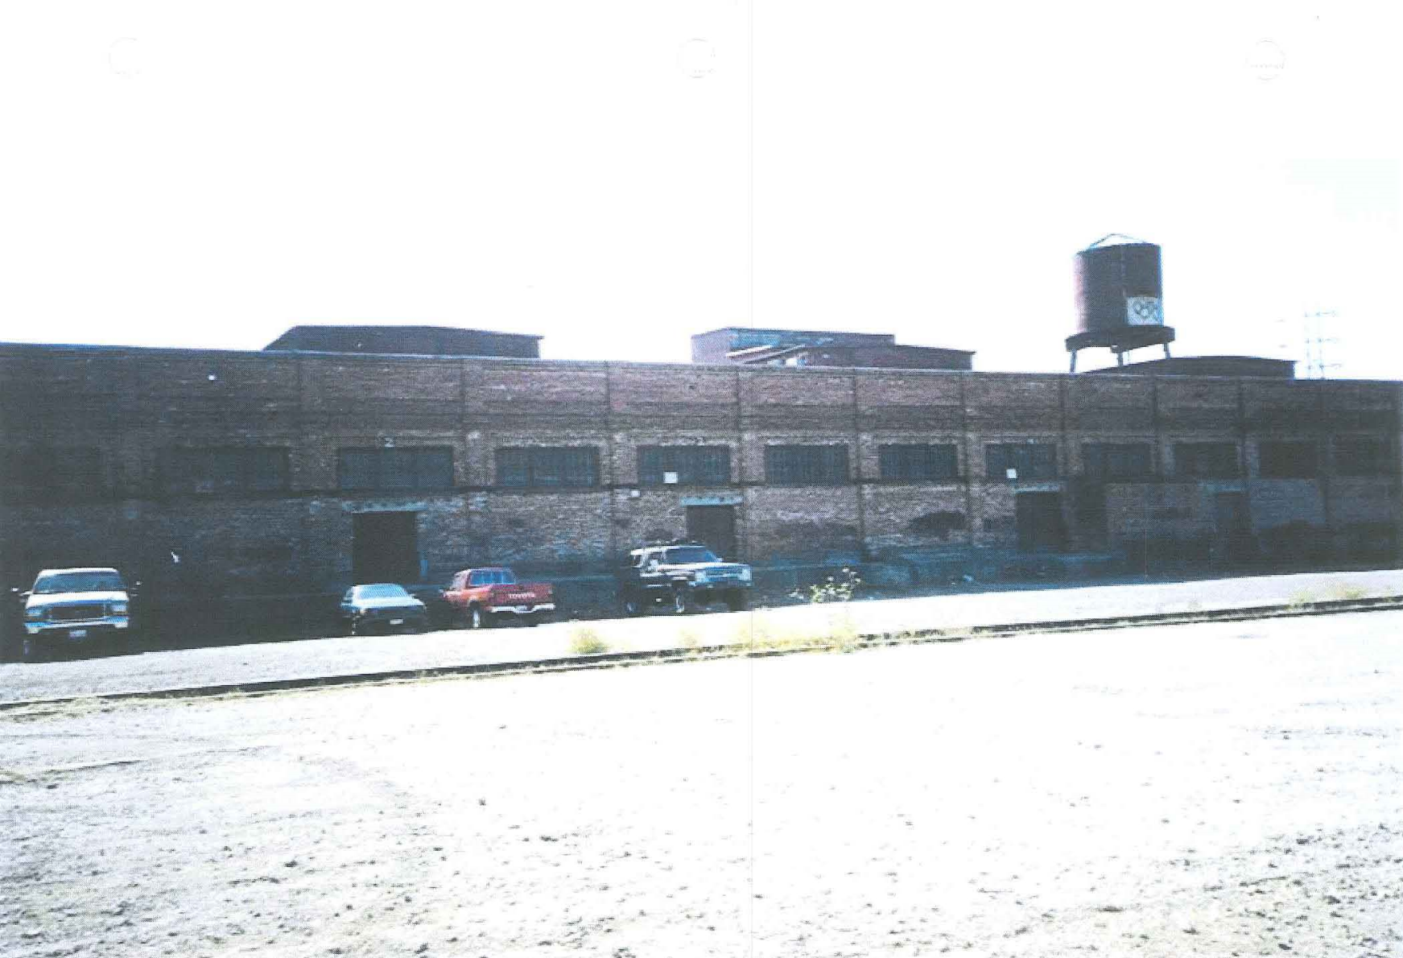
1908 Cannery Looking West

Slide 44
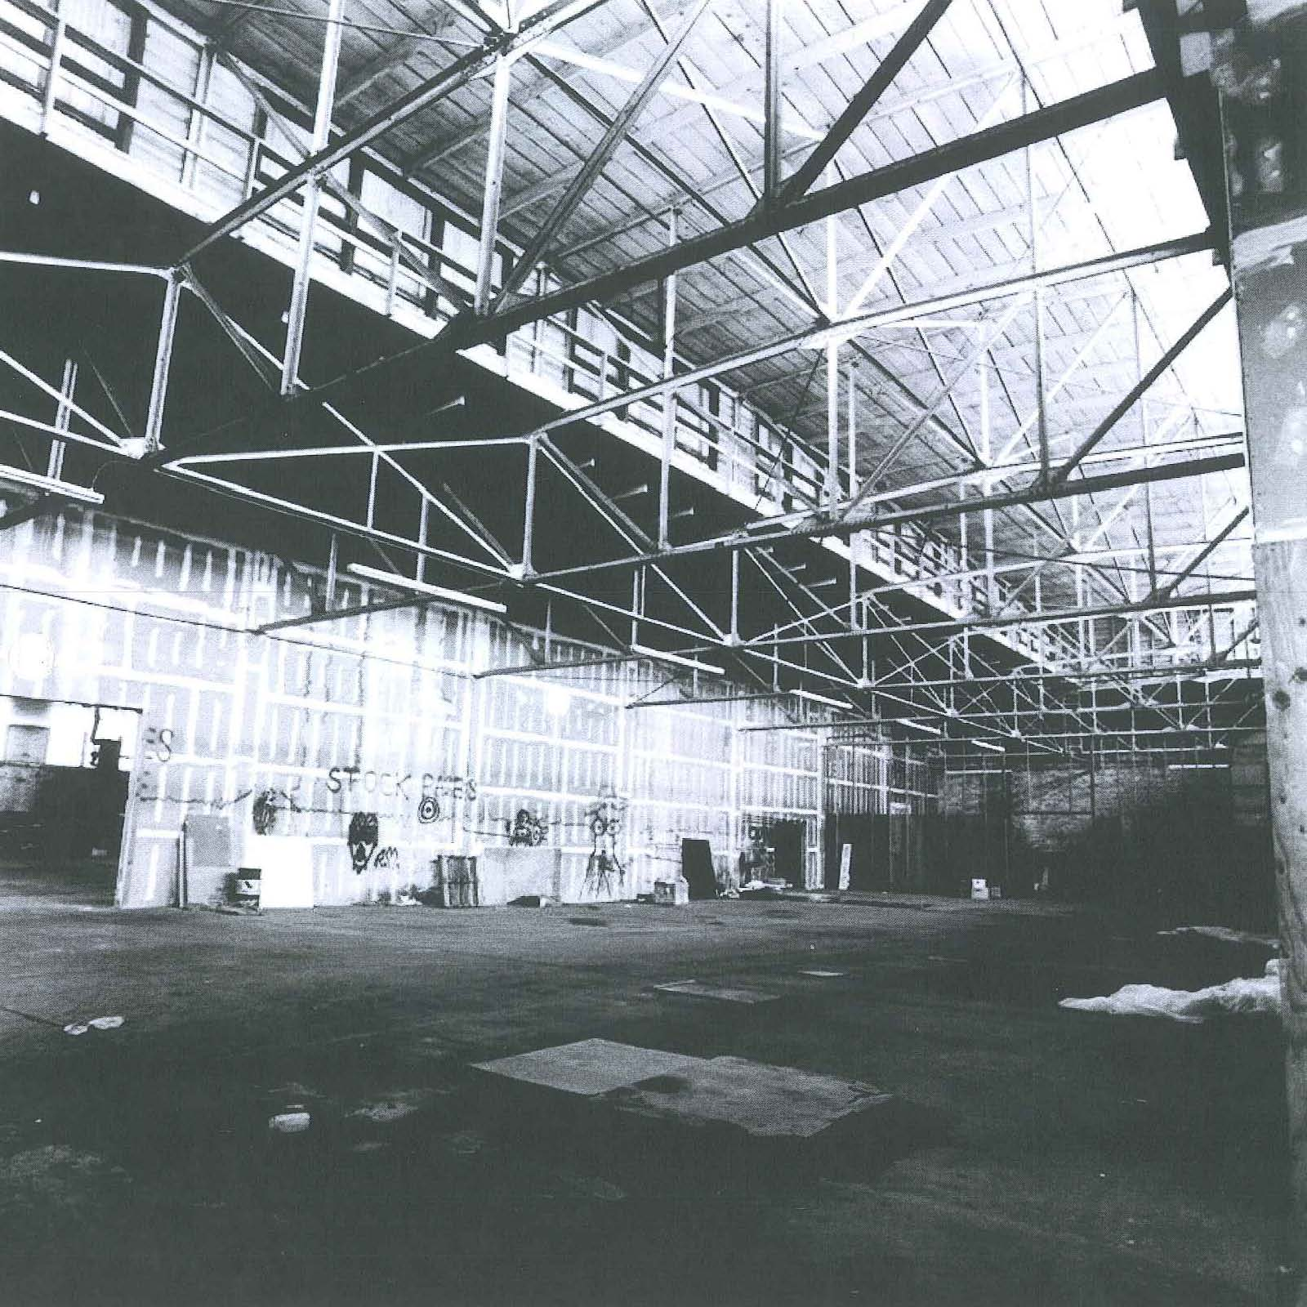
3 West Third Street Cannery Interior

Slide 45
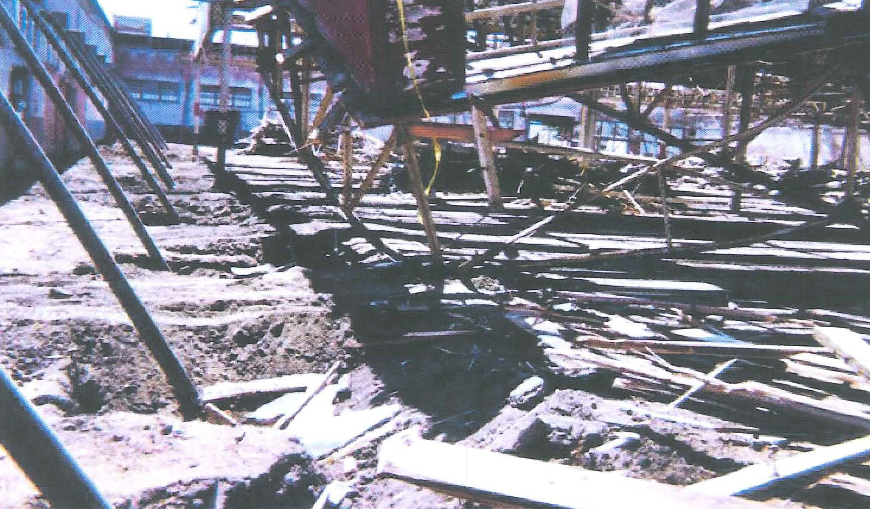
Demolition and wall retention

Slide 46
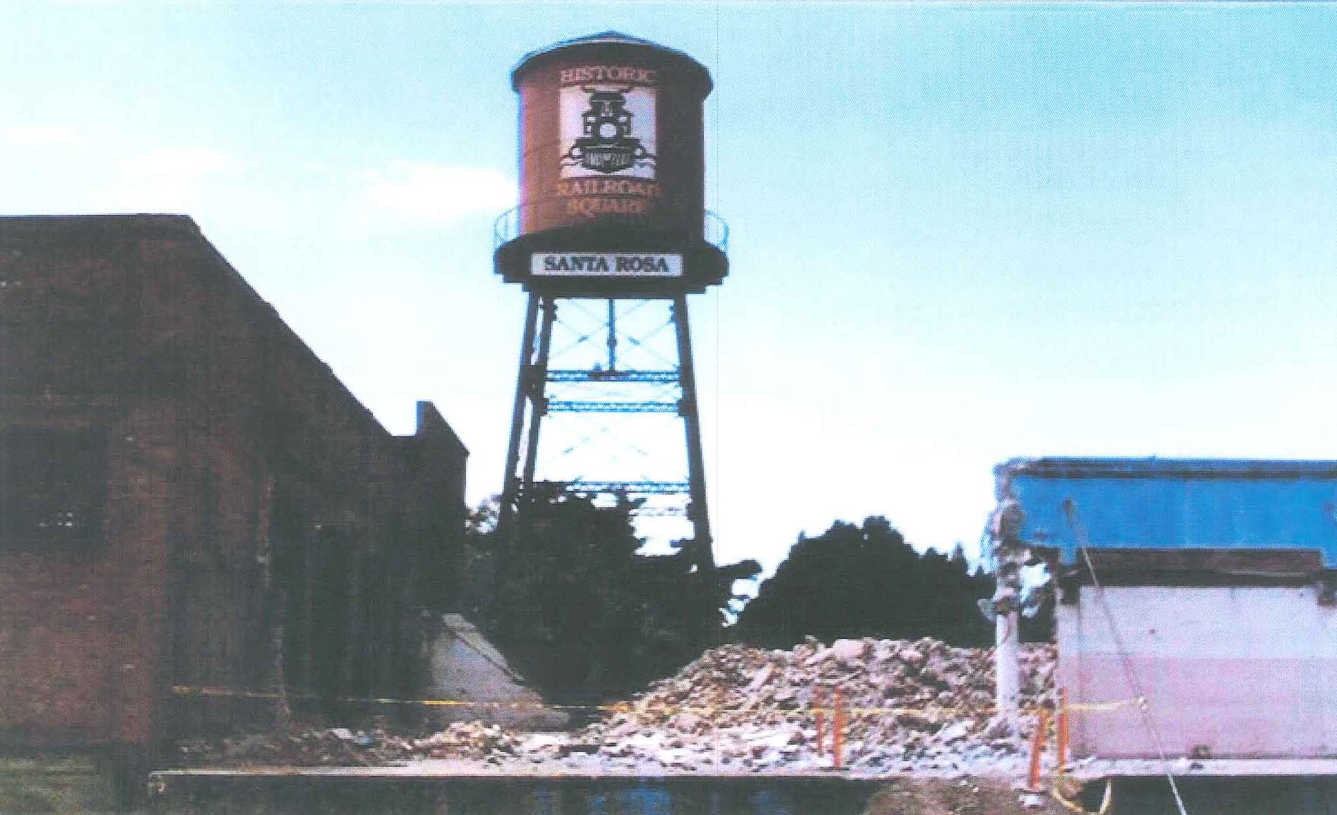
8-story Water Tower & Opening of Pedestrian / View Corridor

Slide 47
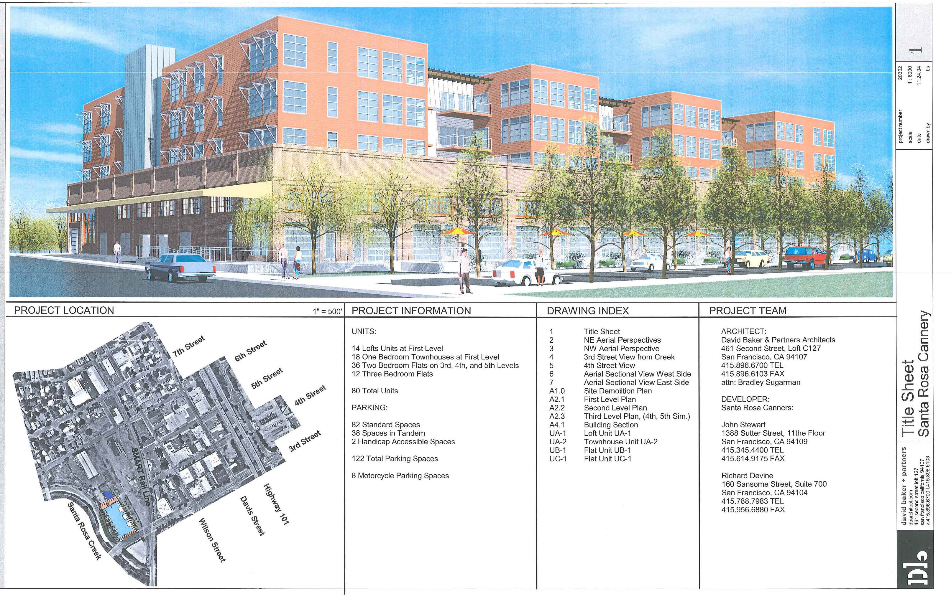
Future Development at 3 West Third Street

Slide 48
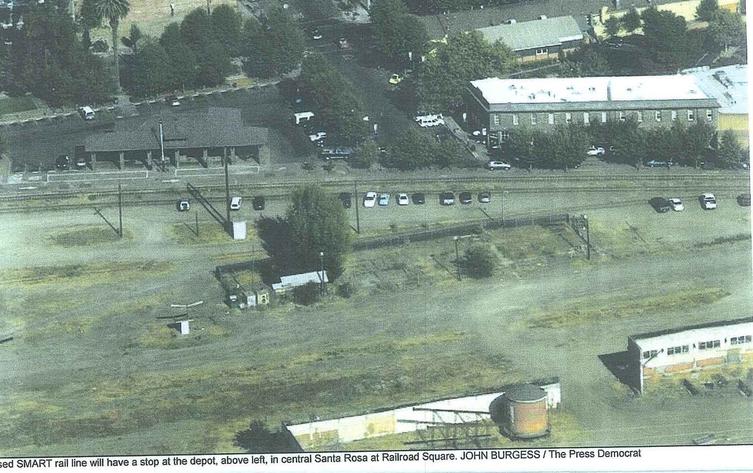
Aerial of Site 2009

Slide 49
Love’s labor lost
  Sonoma County economy tanks
  Sales tax revenue doesn’t fully service bonds
  Train service delayed year-after-year
  Immediate neighbors want up-scale market rate housing
  In 2013, new Mayor & City Council reject project
  $11.3 M Prop 1-C Grant & $5.5 M RDA allocation lost

Slide 50
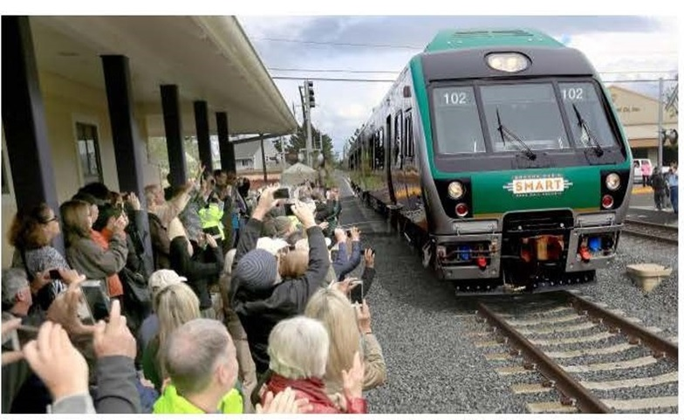
hope springs eternal…
First SMART cars roll into county 2015

